Slide 1
GAN PRESENTATION UNPAIRED IMAGE-TO-IMAGE TRANSLATION
Utkarsh Khurana(20UCS215)
Shubhang Jain (20UCS192)
Course Instructor : Dr. Indra Deep Mastan

Slide 2
TABLE OF CONTENTS
1. Problem Statement
2. Introduction
3. Background
4. Related Works
5. Our Ideas
6. Dataset
7. Experimental Setup
8. Results and Quality Metrics
9. Ablation Study and Discussion
10. Limitations

Slide 3
TABLE OF CONTENTS
6. Dataset
7. Experimental Setup
8. Results Quality Metrics
9. Ablation Study and Discussion
10. Limitations

Slide 4
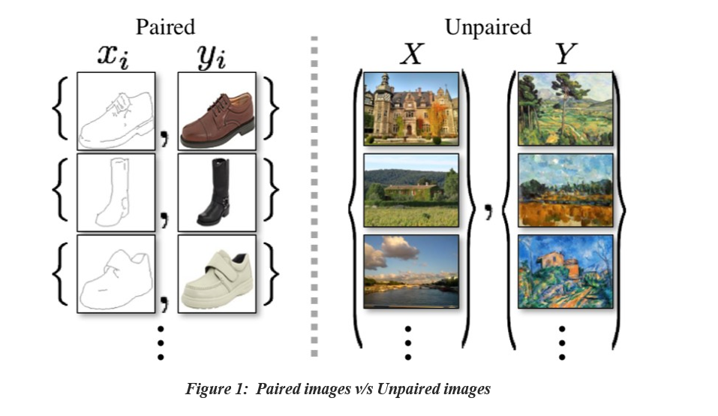
Problem Statement
Unpaired image-to-image translation is a challenging task that aims to transform images from one domain to another domain without the need for
paired training data.

Slide 5
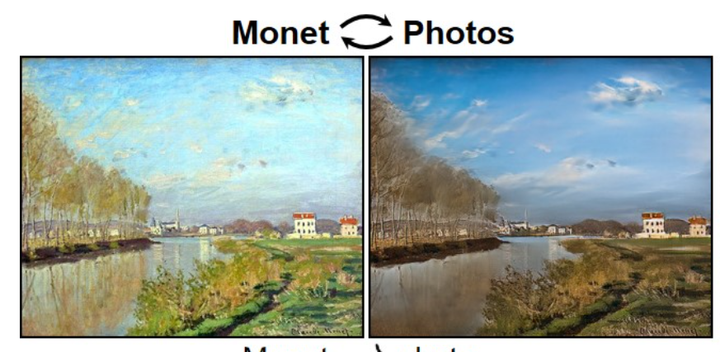
f
The project aims to convert paintings
into photos
Input : Painting
Method : Unsupervised learning using CycleGAN
Output : Photo

Slide 6
2. INTRODUCTION
Leveraging unpaired image datasets, the CycleGAN is able to provide seamless domain transformation, revolutionizing the realm of image translation.
The unpaired image-to-image translation has applications in various domains, such as art, fashion, and computer vision.
We will use CycleGAN to transform paintings into photorealistic images.

Slide 7
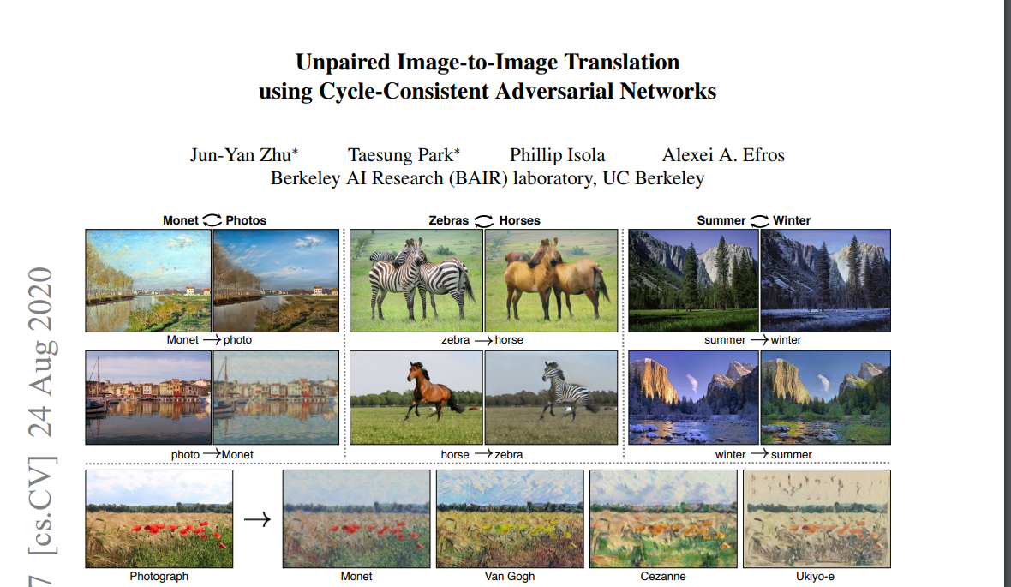
Original CycleGAN paper

Slide 8
3 BACKGROUND
,

Slide 9
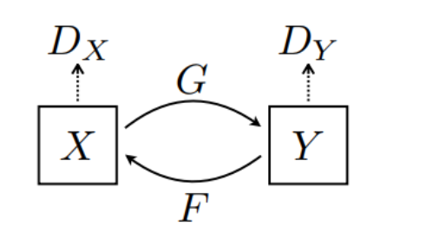
NETWORK STRUCTURE
Has 2 generator network (G and F).
Has 2 discriminator network (Dx and Dy).
Generators have same architecture, but are trained separately.
Discriminators also have same architecture, but are
trained separately.

Slide 10
NETWORK TRAINING
Generator G learns to transform image X to image Y.
Generator F learns to transform image Y to image X.
Discriminator Dx learns to differentiate between image X and generated image X.
Discriminator Dy learns to differentiate between image Y and generated image Y.

Slide 11
LOSS FUNCTION
Weighted sum of adversarial loss and cycle consistency loss.
Adversarial loss : Loss between generated image and image from real distribution.
Cycle Consistency Loss : Reduces possible mapping between the input domain and the output domain

Slide 12
REGULARIZATION
Methods such dropout regularization and gradient penalty are employed to enforce desirable properties, preserve content, and control the smoothness of translations.
Regularization mitigates mode collapse and enhances the overall quality and diversity of generated images in CycleGAN.

Slide 13
BATCH NORMALIZATION
Batch Normalization is applied to both generator and discriminator to overcome overﬁtting.
Batch Normalization is the normalization of
the activation function of each layer.
BN also speeds up learning process.

Slide 14
4
Related Works
Some Baseline Models

Slide 15
.
.
CoGAN
For each domain a generator is learnt.
Furthermore latent representation is used to translate.
Pixel Loss +GAN
Adversarial loss is there to train a translation
Along With a regularization term to penalize the large changes at pixel level

Slide 16
.
.
Feature Loss + GAN
Variant of Pixel Loss+ GAN
Least Absolute Deviation being calculated over deep image features using a pre trained network.
Pix2pix
Simplest implementation
To deﬁne an upper bound
Trained on paired data

Slide 17
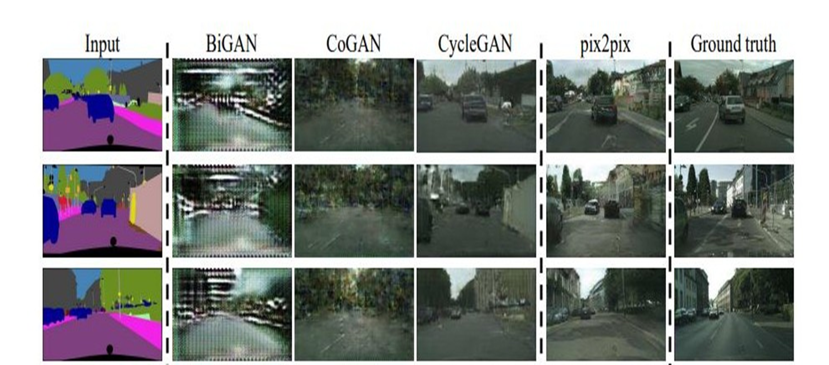
a
.
Comparison with CycleGAN

Slide 18
5. Our Ideas
Making changes to the loss function to see how
it affects our overall performance.
Understanding the importance of cycle consistency loss
by removing loss of one direction at a time.
Record how paired and unpaired datasets
affect our results.

Slide 19
6. Dataset
In this study, we employ the Monet2Photo dataset.
It comprises of 1193 Monet paintings and 7038 real natural photographs.
The data set is already divided into Train_Monet ,
Test_Monet, Train_Real and Test_Real.
We will use the 2 training datasets to train and
2 test datasets of gauge the performance of our model.

Slide 20
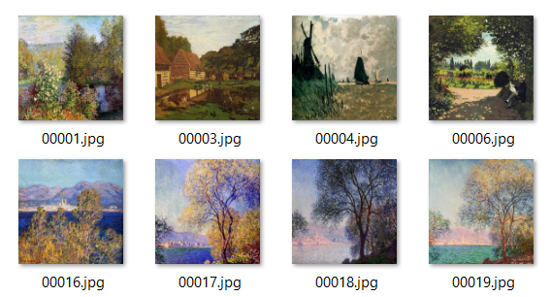

Monet
Natural Images

Slide 21
7. Experimental Setup
The project is conducted on Google Colab, using the notebook "CycleGAN_Monet_to_Photo.ipynb".
Google Colab offers a free GPU environment, optimizing the training efficiency of deep learning models.
We have python libraries TensorFlow, Keras,
NumPy, Matplotlib and PIL (Pillow) .

Slide 22
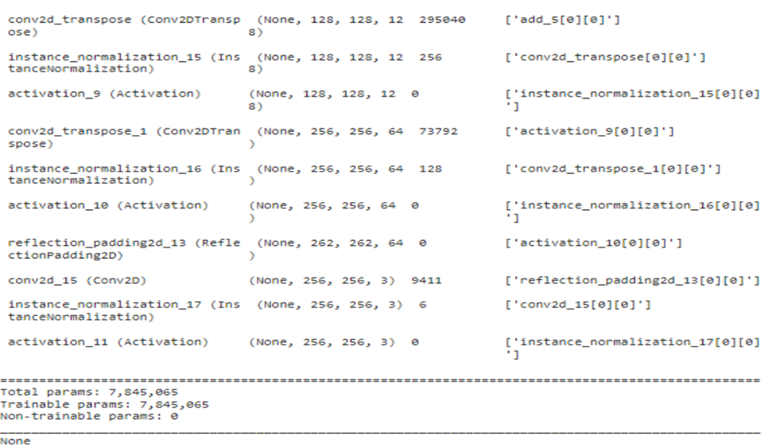
Generator Model

Slide 23
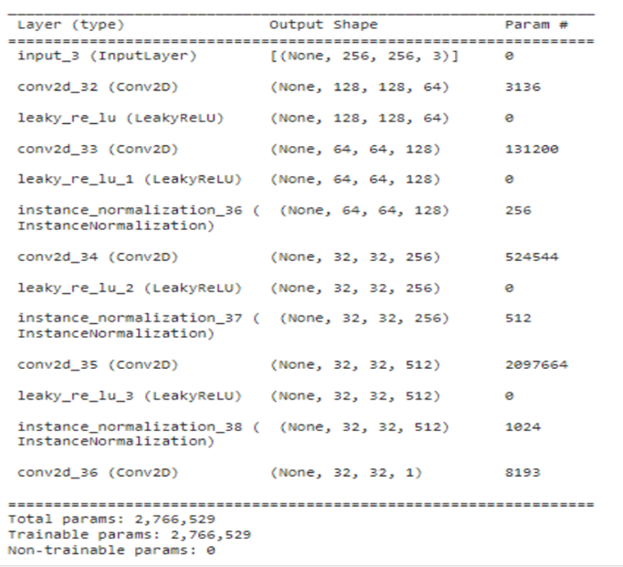
Discriminator Model

Slide 24
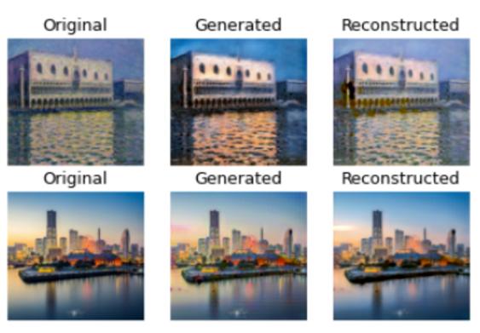
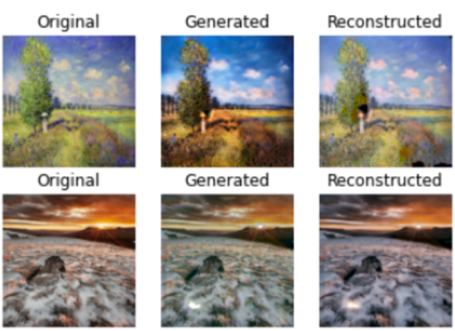
8. Results and Quality Metrics

Slide 25
The trained model successfully created realistic images inspired by Monet's paintings.
Visual Inspection: Comparing the generated images visually with the original images we has see that generator_real is able to capture all painting content and keeps semantic structure intact.
Frechet Inception Distance (FID): 38.6 (Lower is better)
Structural Similarity Index (SSIM): 0.8 ( ranges from -1 to 1 )

Slide 26
ABLATION STUDY
In machine learning, an ablation study involves the systematic removal of model components or features to examine their impact on performance. We received following insights from ablation study:
● Loss is vital for generation of good
realistic images.
● Training the model with either forward
or backward consistency loss results in
MODE COLLAPSE.

Slide 27
Applications
Artistic Style Transfer
Super-resolution
Season Transfer
Object transfiguration
Image restoration
Colorizing legacy photographs:
Data Augmentation

Slide 28
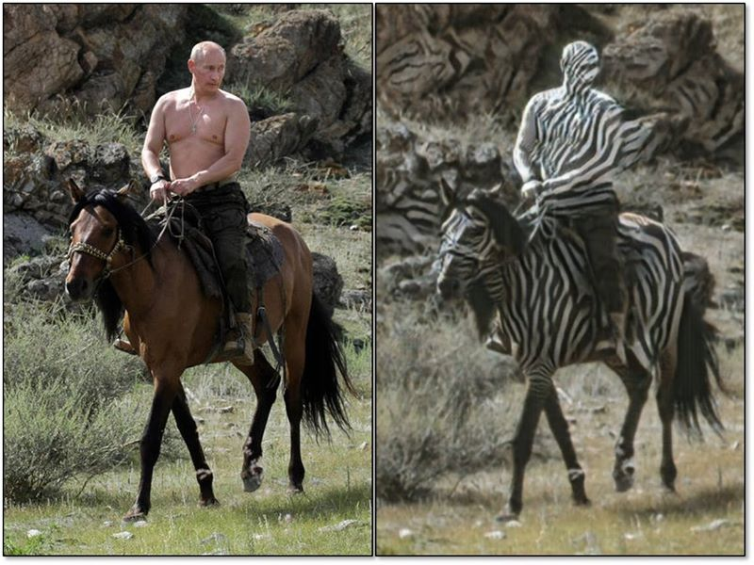
LIMITATIONS
CycleGAN is not able to disentangle the object from the background. Putin and background are both zebraized at the same time, as shown the in the picture.
CycleGAN is suitable for global image style transfer, but weak at doing object transfiguration.
Weak at learning the shape of object. It is impossible if we want to use CycleGAN to generating a round object from a quadrate object.

Slide 29
Reference
Unpaired Image-to-Image Translation using Cycle-Consistent Adversarial Networks https://arxiv.org/pdf/1703.10593.pdf
Generative Adversarial Networks Projects Kailash Ahirwar, Chapter 7
https://www.tensorflow.org/tutorials/generative/cyclegan
Hardik Bansal Archit Rathore [Online] understanding and implementing cyclegan in tensorflow.
Official PyTorch Implementations of Pix2Pix and CycleGAN.
An Introduction to GANs in Tensorflow[Online]- http://blog.aylien.com/introduction-generative-adversarial-networks-codetensorflow/
Taihong Xiao[Online] A Mathematical View towards CycleGAN

